Slide 1


Social Media and Your Parish
Six steps to better social media management
Cathy Dee
OSV Editor for Special Projects
Notes:
Welcome to today’s webcast, ‘Social media and your parish: Six steps to better social media management.’ I’m Cathy Dee, OSV publishing’s Editor for Special Projects. Today our focus is not Social Media 101 -- getting started in social media or setting up social media accounts, although we’ll have some how-to links at the end if you have someone on staff who needs help in those areas. What we’re going to look at are specific ways to fit social media into your already busy schedules. We’re happy to answer questions too and will save some time at the end for those.

Slide 2
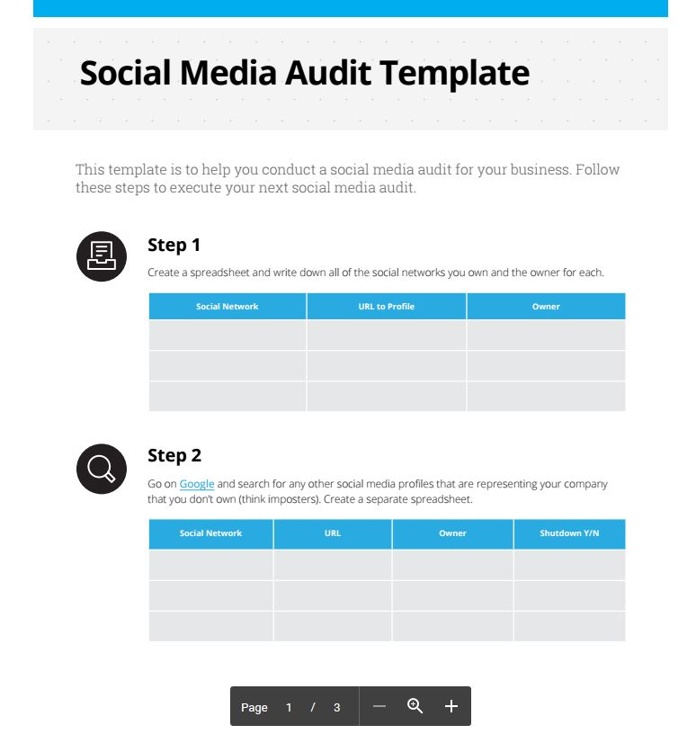
Before you begin…
Conduct a social media audit
What is it?
A social media audit is an inventory of the social media
channels (Facebook, Twitter, etc.) that you’re using now,
and who’s in charge of/posting to them.
The purpose is to discover what’s already in place, determine if the
ownership is correct and to make sure there are no ‘rogue’ accounts out there
that parishioners have started, or that the parish office may have launched, then abandoned.
Ask office people, do a Google search, search on Facebook, Twitter and other channels.
Make a list including account name, URL (web address), login info (including password),
and current owner.
Creating an Excel spreadsheet is a good way using a template like this one
from Hootsuite: https://blog.hootsuite.com/social-media-audit-template/.
Other good how-to advice found there, too.
Notes:
Just to note, special ministries, especially your youth, young adult and other areas might have their own accounts and needs. They may use other channels – Snapchat, for example – that we won’t be talking about today. It might be a good idea for these specialty areas to go through the same audit process and share information. But you need to know where you’re starting from – what accounts you already have – and what you might need to launch.

Slide 3
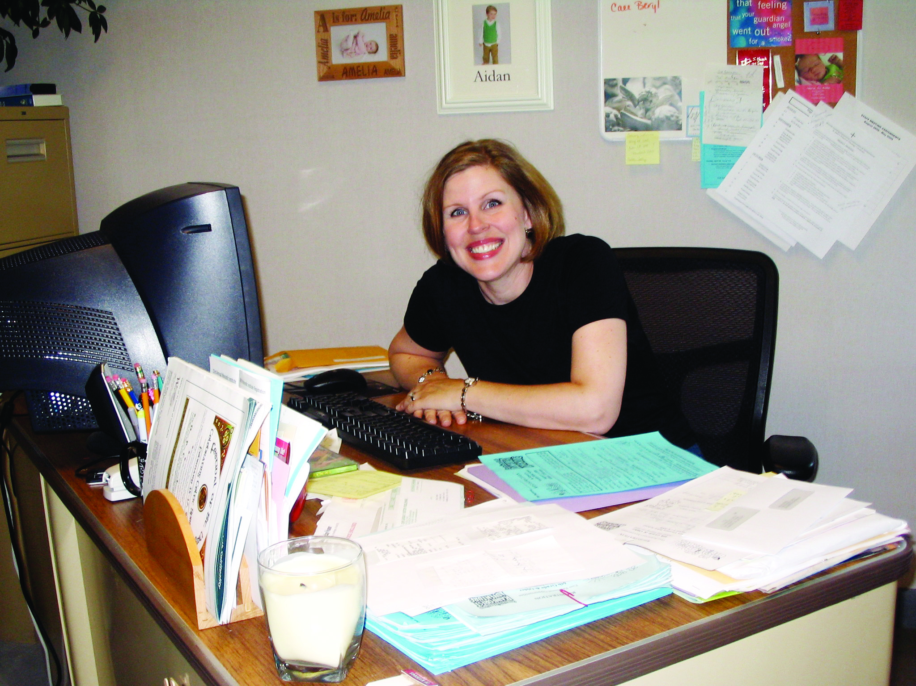
STEP ONE
Choose a Social
Media ‘Manager’
Familiarity with social media channels –
and/or enthusiasm for learning about them
Will put together a social media policy for the parish
Keeps the social media audit document current
‘Gets’ the purpose of social media for your parish
and actively supports its use
Able to delegate posting to trusted others
Wants to have fun!
Notes:
This can be someone in the office or a knowledgeable volunteer. You’ll see a link at the end for social media policy templates, including the USCCB guidelines.

Slide 4

STEP TWO
Choose your
social media channels
So many channels, so little time:
LIMIT the number of channels you post to
If you’re found inactive channels during your social media
audit, shut them down.
Recommended: Facebook page, Twitter, Instagram
Consider: YouTube, Pinterest, Periscope, Flickr
KEEP SAFE TRACK OF THOSE LOGINS! Consider using a
password tracker like LastPass.
Notes:
Don’t feel as if you need to be EVERYWHERE – choose your channels and do them well! Also, remember you’re using social media in concert with your web site, printed materials and app. PICTURES PICTURES PICTURES – you can use FB for your picture albums. Photobucket and other favorite sites if you have them. Link at the end for LastPass and other password managers. LIVESTREAMING on FB, Twitter (Periscope), Livestream, YouTube, other services

Slide 5

STEP THREE
Set your social media
content agenda
EVANGELIZE. We are here to spread the Word of God – use
your social media channels to let people know about
the joy in your parish
INFORM. There’s lots going on. Let people know!
SUPPORT. Your parish ministries are there to accompany
people on their spiritual journey.
Post from your web site, trusted Catholic news sites,
parish calendar, diocesan paper, online bulletin, and
PICTURES PICTURES PICTURES!
The number of posts per day or week is up to you – too few
and people forget you; too many and it’s annoying.
Notes:
By focusing on just a few areas to post about, you avoid scattershot post and feeling as if you have to post everything. How often should you post? One Facebook, twice a day at most – at least, three times a week. Remember posts can be scheduled. On Twitter, there may not be too much. Tweet away! Instagram – one to three a week? Once a day is not too much. Pinterest – upload posts once a week. Photos – as needed. Livestreaming – when something interesting happens (Mass, school program, etc.) You probably already have a strong parish community – let your social media efforts build and amplify on that. Take advantage of scheduling through Facebook, Tweetdeck or Hootsuite or other social media manager for stuff on your calendar, liturgical dates and other scheduled stuff.

Slide 6
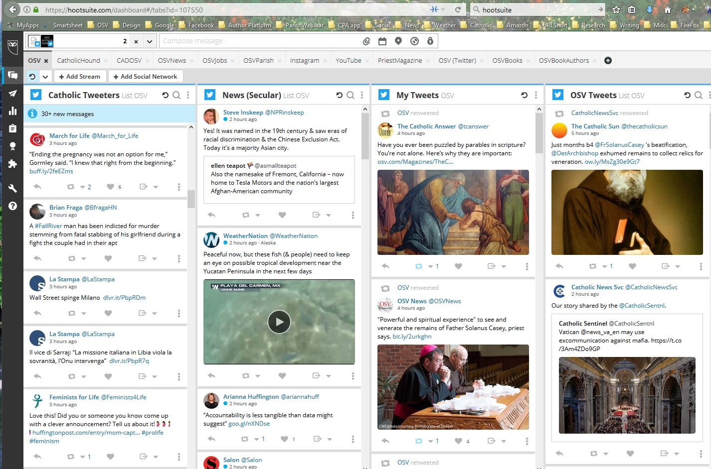
STEP FOUR
Use smart tools
Use your smartphone, iPad or tablet.
All social channels have excellent mobile apps.
Use a password manager like LastPass.
Consider using a dashboard like Tweetdeck, Hootsuite or
Sprout Social to bring your accounts together in one place
and make it easier to schedule, monitor comments and
answer questions.
Set your notifications so you’re not a slave to your device
(Quiet hours, selected notifications)
Use a tool like IFTTT to create applets and multi-post
automatically
Notes:
Some channels, like Instagram, must be posted to by mobile apps.

Slide 7
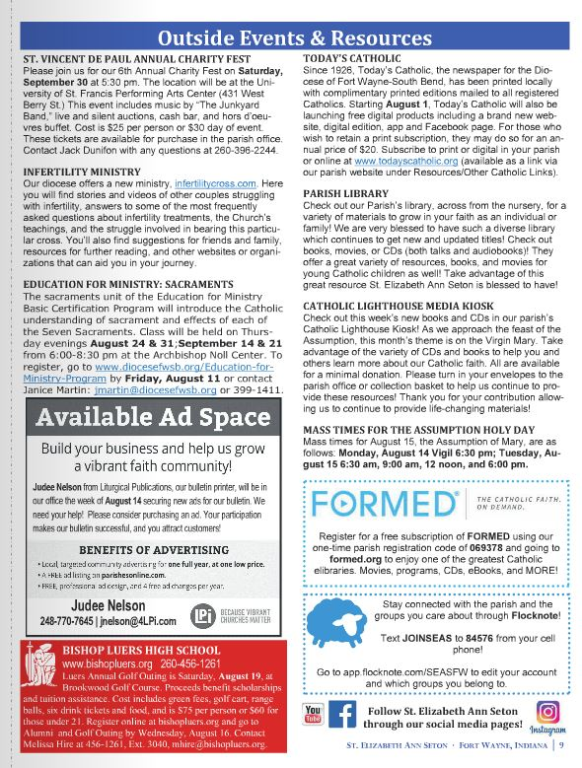
STEP FIVE
Spread the word
Use your bulletin and newsletters to
let people know where your parish
can be found on social media.
Make sure your web site is optimized for social –
make pages and stories easily shareable.
Make sure your social channels are part of your web site
template so people can follow you easily.
Mention your social presence during Sunday announcements
once a month or so.
Have a parish app that includes shareable content and has
links to your social channels and can send notifications.
Notes:
Be dependable about what you share! Important dates life First Communions, Confirmation … reminders like when the church is not available (like for a wedding) … parish festival information … school closings … Mass time changes … You parish app is a good way to share this info but as you know the more ways you can reach people, the better!

Slide 8

STEP SIX
HAVE FUN
The work of the Lord is serious, but that doesn’t mean Christians aren’t joyful! Let people know in your posts
-- especially your pictures – that your community of believers is filled with the love of the Lord!

Slide 9

Wrapping up
Today’s Takeaways
First, do a social-media audit
so you get a snapshot of tools your parish
is already using.
1. Pick a parish point person to assure organization
2. Be selective about the social media channels you use.
3. Know where your content is coming from.
4. Use smart tools like apps, scheduling, managers.
5. Let your parish know where to find you.
6. Have fun!
Notes:
The patron saint of the internet as proposed by St. Pope JPII is Isidore of Seville, who tried to record everything ever known – first encylopedia. In 1997 Pope John Paul II declared Isidore of Seville the patron saint of the internet.

Slide 10
Resources
USCCB Social Media Guidelines http://www.usccb.org/about/communications/social-media-guidelines.cfm
Social media policy for churches http://socialchurch.co/social-media-policies-churches-ministries/
How to sign up for Twitter https://support.twitter.com/articles/100990#
How to create a FB FAN page https://www.facebook.com/pages/create/
Four Reasons Why Your Church Needs a Facebook Page http://catholictechtalk.com/2016/02/03/5871/
How to sign up for Instagram https://help.instagram.com/1642053262784201/
Using Periscope https://pikemalltech.com/how-to-use-periscope-for-education/
How to sign up for YouTube https://www.lifewire.com/youtube-account-signup-2655499
How to sign up for Pinterest https://www.lifewire.com/get-a-pinterest-account-2654220 (use business option)
How frequently should you post? https://www.forbes.com/sites/neilpatel/2016/09/12/how-frequently-you-should-post-on-social-media-according-to-the-pros/2/#3bc6679e100f
Best password managers https://www.pcmag.com/article2/0,2817,2407168,00.asp
LastPass password manager: https://www.lastpass.com
5 social media tools to save time www.socialmediaexaminer.com/5-social-media-management-tools-to-save-time/
Hootsuite social media audit tools https://drive.google.com/file/d/0B9Gnigjqdhfqbi1xR3JJUnE1eWc/view
IFTTT https://ifttt.com/about
7 keys to a church social media strategy http://www.lifeway.com/pastors/2017/01/03/keys-effective-church-social-media-strategy/
Sample consent forms http://blog.suzi-pratt.com/parental-consent-form-template/
Catholic Tech Talk www.catholictechtalk.com
Marketing your parish http://www.ecatholicblog.com/marketing/
Parish social media resources from The Religion Teacher https://www.thereligionteacher.com/todaysparish/
Parish Guide to Social Media by Clarissa Aljentera http://amzn.to/2uhSrwO
The Social Media Gospel: Sharing the Good News in New Ways by Meredith Gould http://amzn.to/2hBrmi3
Notes:
Also – don’t be afraid to change your tools, channels and methods as necessary.

Slide 11
Social Media and Your Parish
Six steps to better social media management
QUESTIONS?
Notes:
Welcome to today’s webcast, ‘Social media and your parish: Six steps to better social media management.’ I’m Cathy Dee, OSV publishing’s Editor for Special Projects. Today our focus is not Social Media 101 -- getting started in social media or setting up social media accounts, although we’ll have some how-to links at the end if you have someone on staff who needs help in those areas. What we’re going to look at are specific ways to fit social media into your already busy schedules. We’re happy to answer questions too and will save some time at the end for those.

Slide 12
THANK YOU!
Download these slides at http://bit.ly/2hChbK1

